Slide 1


Delivery Playbook - Java
May 2023

Slide 2

Purpose of this playbook
Describe the approach to overall delivery of a typical Java project for a subset of the organization( wave) that is embarking upon larger transformation program
Provide detailed guidance/picture on the key activities to be performed as part of overall Delivery
Approach to various phase of implementation
Recommended Project execution life Cycles @Capgemini
Guidelines and roadmaps to be followed for a selected SDLC cycle
Standards and tools applicable for engagements
Methodology and checklists
Governance and Reusable artifacts
Does not explore the benefits and rationale for adopting a particular way of delivery cycle
Does not provide a holistic compendium/how to guide on the Delivery process.
This playbook is a living document that will evolve as the team continues to embark of new projects and learn through its implementation

Slide 3






Contents of this playbook
Component
Questions addressed
Concepts
What are the best practices for this topic
Set up and Guidelines
How can I apply the concepts for this topic
Templates/Example
How does it work in practice
Checklists
What are the guard rails and guide rails
Phase wise tools
Tools that can be considered during each
phase of this topic
References & Inventory
References ( internal and external)

Slide 4
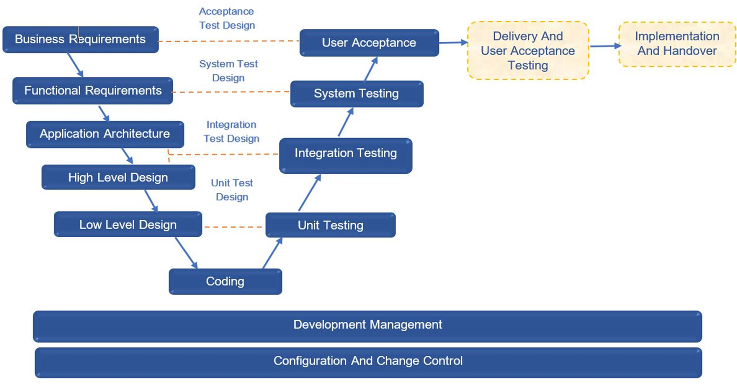
Typical Java Delivery lifecycle

Slide 5
JAVA DELIVERY LIFECYCLE – Deliverables
Phases | Entry Criteria | Tasks | Verification | Exit Criteria
Business Requirements | Proposal MSA, SOW or LOI | Capture And Analyze Business Requirements Provide High level estimates for budgeting Develop Test Strategy Create Acceptance Test Plan And Test Cases | Review and sign off of Business Requirements, test strategy | •Baselined Business Requirement Document •Baselined Test Strategy •Traceability Matrix updated with Business Requirements and User Acceptance Testcases •User Acceptance Test Plan and Test Cases
Functional/Non- Functional Requirements | Business Requirements NFRs Traceability Matrix Test Strategy | Capture And Analyze Functional Requirements Create System Test Plan Create Performance Test Plan Create System Test Cases Create Test Data | Review and sign off of Functional/Non-Functional Requirements, test plan and test cases | Baselined Requirement Specification Document Baseline NFR specs with defined Acceptance criteria Baselined System Test Plan and Test Cases Traceability Matrix updated with Functional requirements and System Testcases
Solution Architecture | Requirement Documents Traceability Matrix | Understand Architecture Requirements Create Architecture document | Review and sign off of Architecture document | Baselined Architecture Document Traceability Matrix updated with Architecture details
High Level Design | Requirement Documents Architecture Document Test strategy, system test plan and testcases | Create High Level Design Document Create Integration Test Plan Create Integration Test Cases | Review and sign off of HLD document, IT test plan and test cases | Baselined High Level Design Document Baselined Integration Test Plan and Test Cases Traceability Matrix updated with High Level Design and Integration Testcases
Low Level Design | High Level Design Document Updated Traceability Matrix Architecture Document Requirement Specification Document | Create Low Level Design Create Unit Test Cases | Review and sign off of LLD document and UT cases | Baselined LLD Document Baselined Unit Test Cases Traceability Matrix updated with Low Level Design details and the Unit Testcases

Slide 6
JAVA DELIVERY LIFECYCLE – Deliverables
Phases | Entry Criteria | Tasks | Verification | Exit Criteria
Development/Unit Testing | High Level Design Document Low Level Design Document Architecture Document Requirement Specification Document | Perform Coding by following test driven development and coding standards Establish CI/CD pipeline Run code quality tools in the IDE Fix the code quality issues, Check-in the code daily into the config repository Perform Code Review by following pull approach and fix code review comments Perform Unit Testing and fix the defects | Code quality checks using tools Manual Code reviews and signoff Code coverage checks using tools | Baselined Source Code Traceability Matrix updated with Source Code details Code quality targets passed Manual Code reviews and signoff Code coverage targets passed
Integration Testing | Integration Testcases Integrated Source Code | Perform Integration Testing and fix the defects | Quality gate checks using tools integrated into CI/CD pipeline | Quality gates passed
System Testing | System Testcases Requirement Specifications Build System Test Environment | Set Up System Test Environment Perform System Testing and fix the defects | Test coverage Test execution results Release/product delivery audits | System Test Results Passed User documentation Release notes
User Acceptance Testing | Acceptance Test Plan/Cases Business Requirement Document UAT Test Environment | Provide Support for Acceptance test by customer and fix the defects | UAT coverage Test execution results | Acceptance Test Results Passed UAT Signoff from Customer and Go-live approval
Implementation | Release Package Implementation Plan Release Notes UAT Signoff from Customer | Prepare For Implementation Deploy The code in production Conduct User Training Cut over and go live | Review and Sign off on successful deployment | Successful code deployment in Production
Warranty and Handover | Training Materials All deliverables from above steps | Provide Warranty Support Handover To Support | Review and sign off of Handover document | Handover to support team successfully completed

Slide 7
Recommended Standards, Tools, Frameworks
Standards/Tools/Frameworks | Recommendations | Comment
Language | Java 8+ | Availability of latest features
SDLC methodology | Agile Iterative | Agile is commonly used both for development and prod support
Coding Framework | IntelliJ Eclipse | Most used IDEs
Build Tools | Maven Gradle
Logging Framework | Log4J slf4j | Well known logging frameworks for Java
Testing | JUnit Mockito Swagger Postman | Well known testing frameworks/tools for Java
CI/CD | Jenkins
Source code Management | Git GitHub Bit Bucket SVN | Easy collaboration Automatic merges
DevOps/ALM tools | Jira Confluence | Commonly used
Monitoring | Splunk Elastic

Slide 8
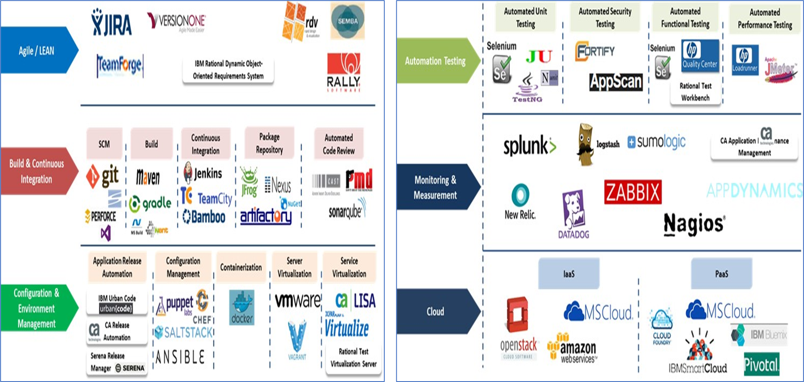
Delivery Tools – Engineering

Slide 9
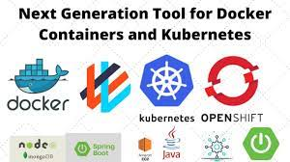
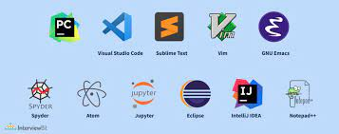


Delivery Tools – Engineering
Containers
IDE
Collaboration
Unit Testing

Slide 10
Reference to Delivery Play Book
Delivery Playbook v1.docx

